Slide 1
CHAPTER 2.7:
USING THE DISTRIBUTIVE PROPERTY
Algebra concepts

Slide 2
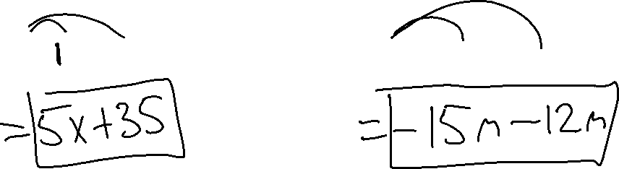
The Distributive Property
Ex. 1) 5(x + 7)
Ex. 2) 3(-5m – 4)

Slide 3
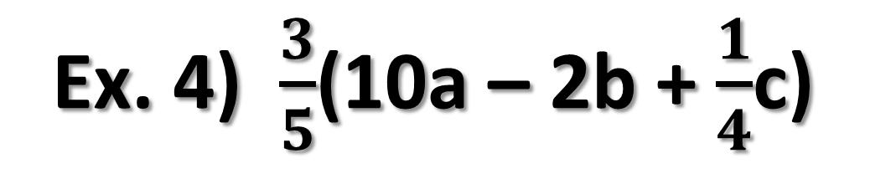
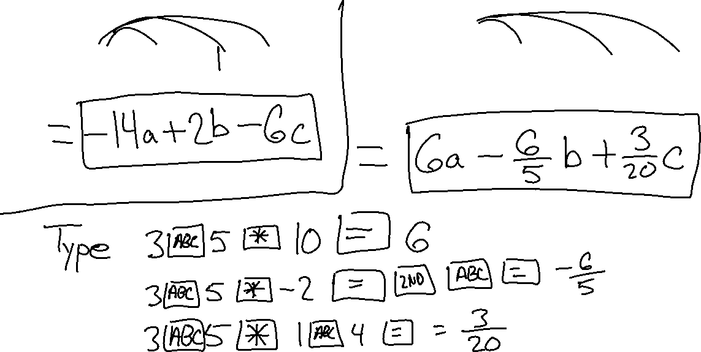
Ex. 4) $\frac{3}{5}$(10a – 2b + $\frac{1}{4}$c)
Ex. 3) – 2(7a – b + 3c)

Slide 4
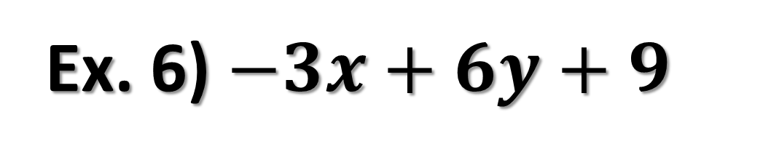

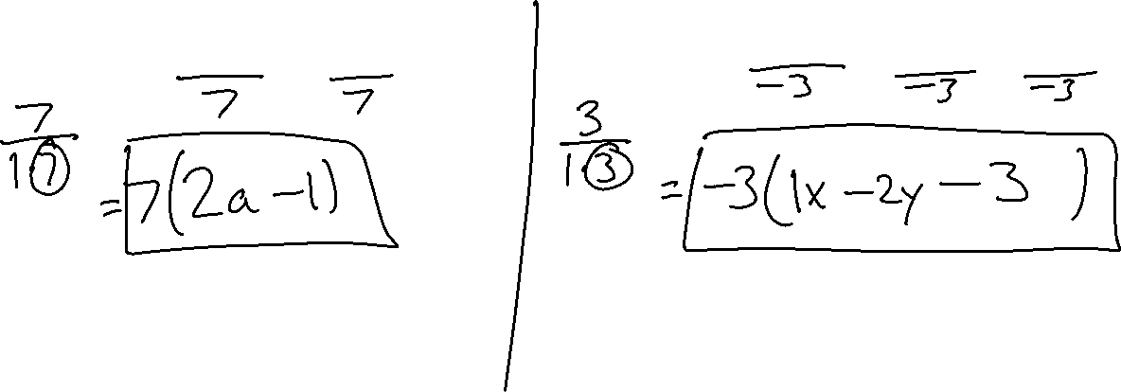
FACTORING
Ex. 5) $14a−7$
Ex. 6) $−3x+6y+9$

Slide 5
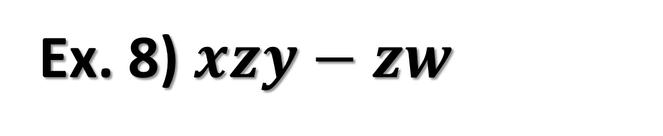
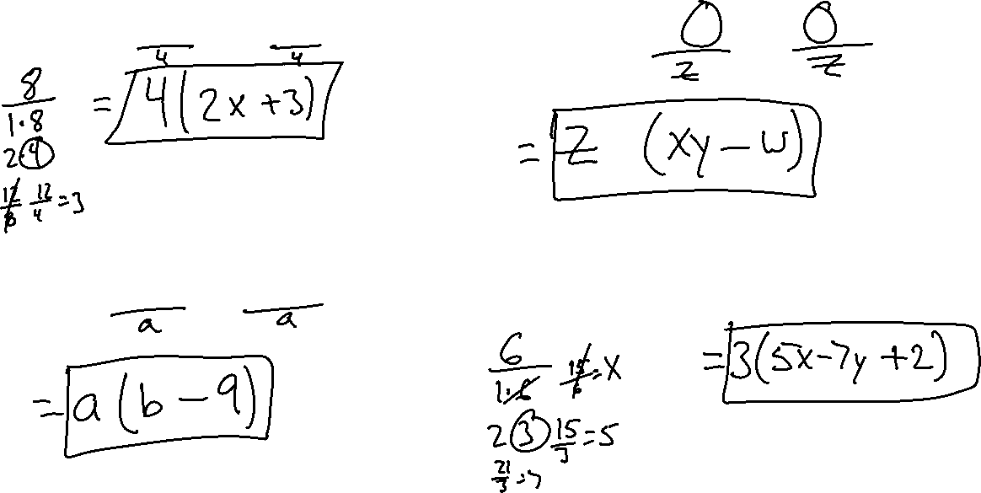
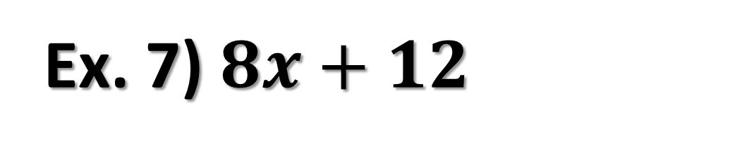
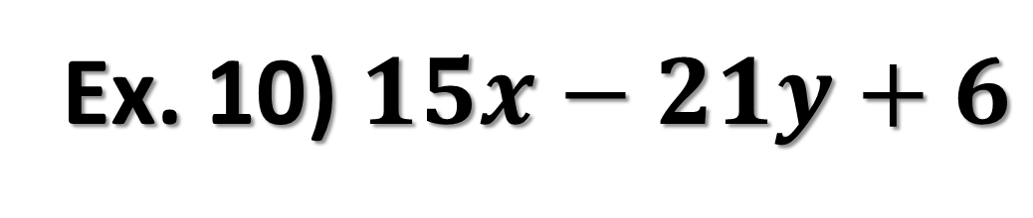

Ex. 7) $8x+12$
Ex. 8) $xzy−zw$
Ex. 9) $ab−9a$
Ex. 10) $15x−21y+6$

Slide 6
A term is a:
1) number,
2) variable, or
3) a product / quotient of numbers and variables,
Example: 5, m, 2x²

Slide 7
Like Terms are terms with the same variable AND exponent.
To simplify like terms, simply combine the like terms by adding the coefficients.
  Don’t Change the Variables

Slide 8
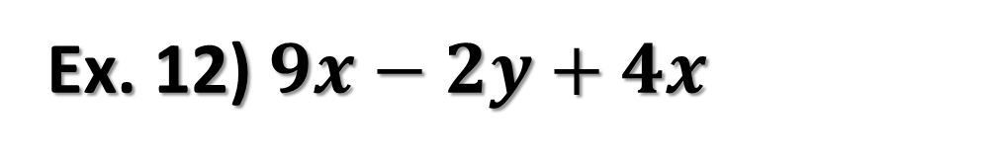
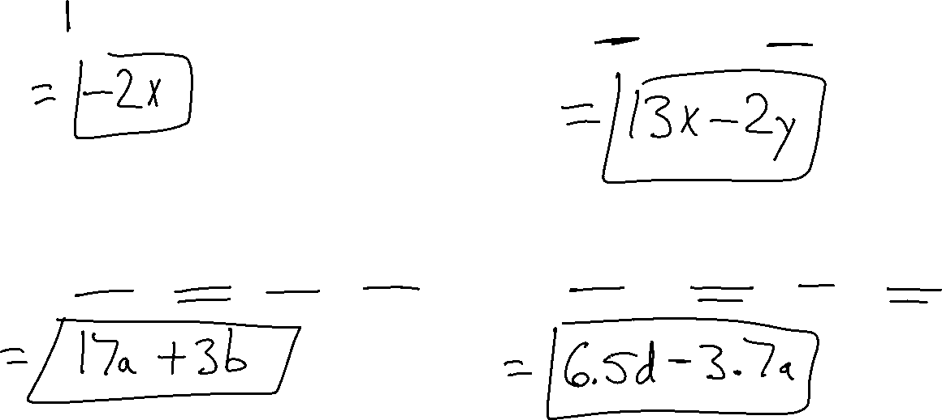
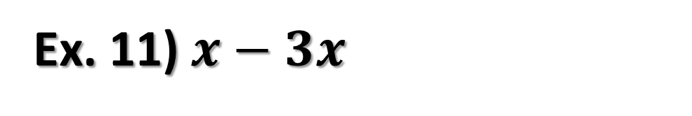
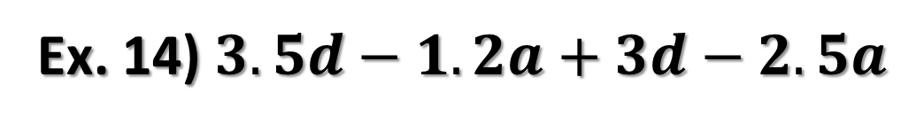
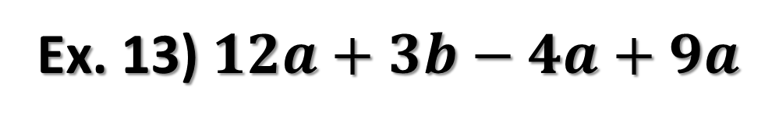
Ex. 11) $x−3x$
Ex. 12) $9x−2y+4x$
Ex. 13) $12a+3b−4a+9a$
Ex. 14) $3.5d−1.2a+3d−2.5a$

